Slide 1

DS-GA 1011 Fall 2017
Lab 8
Neural Attention & Machine Tranlsation
Artie Shen | Center Data Science

Slide 2
Overview
In this lab, we will:
  Tackle the problem of translating French to English
  Build an encoder–decoder model for machine translation
  Augment the encoder – decoder network using neural attention

Slide 3
Dataset
Tab-delimited Bilingual Sentence Pairs
  Example
    tu es tres intelligente, you are very intelligent
  A subset of 10853 French-English sentence pairs
  Average sentence length = 6 words
  Small vocabulary base
    4489 French words
    2925 English words

Slide 4
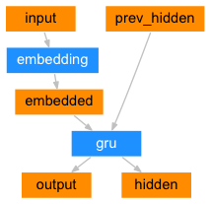
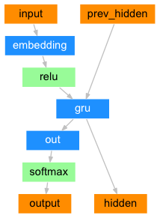
Encoder & Decoder

Slide 5
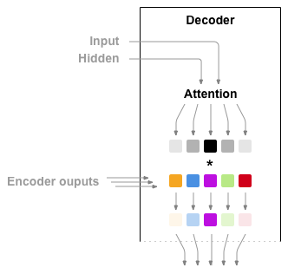
Attention
For each decoder output o_t
Compute attention a_t weights using:
  Input: o_t-1 the previous output token
  Hidden: h_t-1 the previous hidden state
attn_weigths: a_t has dimension equals to the # of tokens in the source sentence

Slide 6
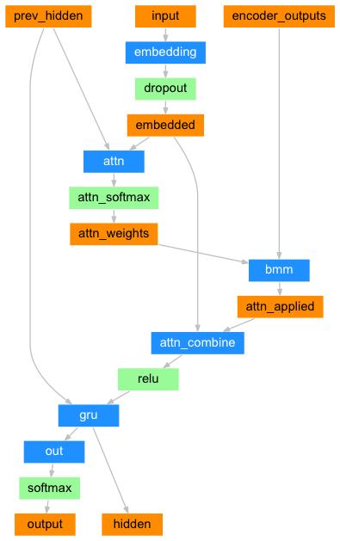
Decoder with Attention
attn_applied: weighted sum of all encoder_outputs where weights is specified by attn_weights
attn_combine: relu(concat(o_t-1, attn_applied))
output: softmax(gru(attn_combine))

Slide 7
Task
You are provided with:
  the model structures
  training procedure
You are asked to:
  Finish the code that constructs the translated sentence
  Finish the code that visualizes the attention

Slide 8


